Slide 1



Market Basket Analysis
Association Rule Mining in Data Mining
Notes:
1

Slide 2

What Is Market Basket Analysis?
Market Basket Analysis (MBA) is a data mining technique that examines customer purchasing behaviour to uncover relationships between items bought together. By analysing transactional data, it helps retailers understand buying patterns and make smarter business decisions.
Transactional Data
Pattern Discovery
Analyses records of customer purchases
Identifies which items are frequently bought together
Business Insight
Supports decisions on layout, promotions, and stock
Notes:
2

Slide 3


The Basic Concept
MBA examines which items are frequently purchased together in a single transaction. Each transaction is referred to as a basket. The goal is to discover hidden patterns that are not immediately obvious.
Classic Example: Customers who buy bread often also buy butter. This simple observation, when scaled across thousands of transactions, reveals powerful purchasing trends.
Notes:
3

Slide 4

Association Rule Mining
Association Rule Mining is the core technique behind Market Basket Analysis. It searches large datasets to find relationships between variables and expresses them as rules of the form If X, then Y.
Antecedent
Consequent
Example: If a customer buys milk → they may also buy bread. These rules help retailers predict what customers are likely to purchase next.
Notes:
4

Slide 5
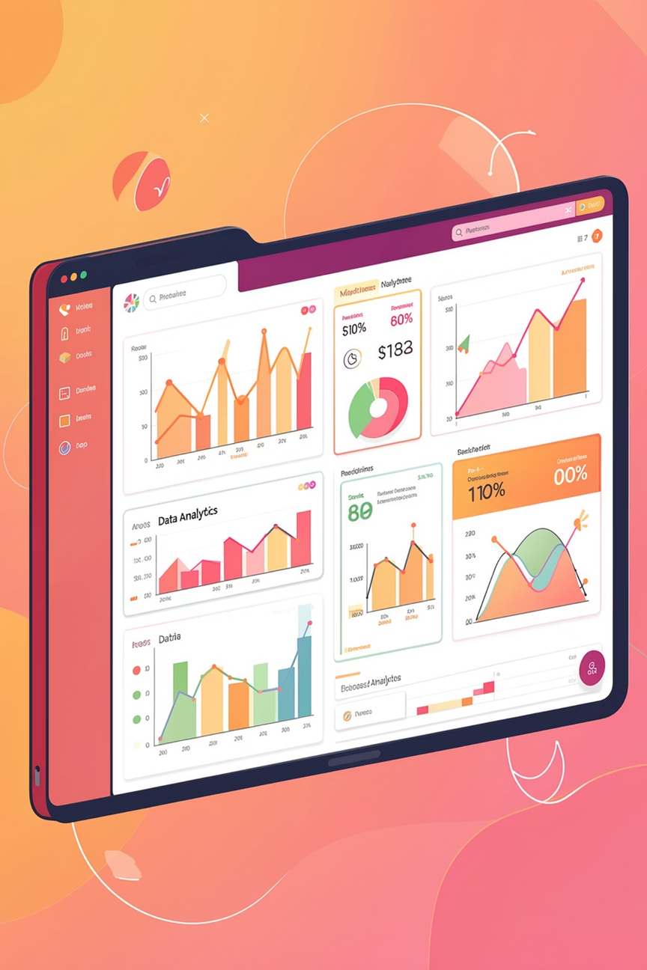
Key Terms to Know
Itemset
A collection of one or more items that appear together in a transaction.
Support
The frequency with which an itemset appears across all transactions.
Confidence
The likelihood that item Y is purchased when item X is purchased.
Lift
Measures the strength of a rule compared to random chance — values above 1 indicate a meaningful association.
Notes:
5

Slide 6
How It Works: The Process
Collect Transaction Data
1
Gather records of customer purchases
Identify Frequent Itemsets
2
Find item combinations that occur often
Generate Association Rules
3
Derive "If X, then Y" rules from itemsets
Evaluate Rules
4
Assess rules using support and confidence
Select Strong Rules
5
Keep only the most useful and actionable rules
Notes:
6

Slide 7
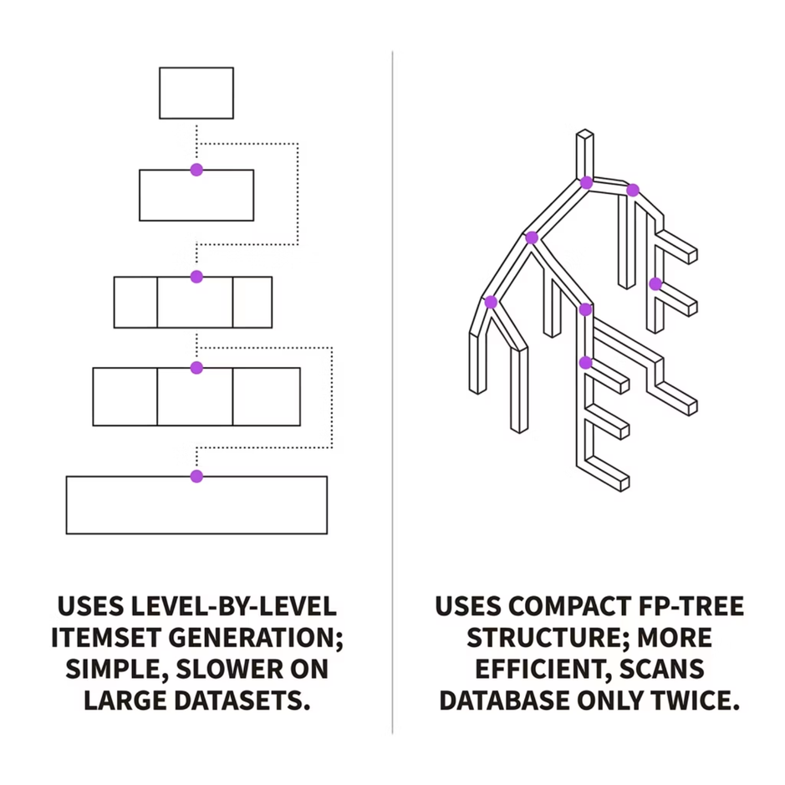

Popular Algorithms
Apriori Algorithm
Works level by level, generating candidate itemsets and pruning those below a support threshold. Simple to understand but can be slow on very large datasets.
FP-Growth Algorithm
Builds a compact tree structure (FP-tree) to mine frequent patterns without candidate generation. Significantly faster and more memory-efficient than Apriori.
Notes:
7

Slide 8





Advantages of Market Basket Analysis
Better Product Placement
Group related items strategically to increase visibility and sales.
Cross-Selling & Upselling
Recommend complementary products to boost average transaction value.
Enhanced Customer Experience
Personalise shopping experiences based on discovered buying patterns.
Data-Driven Decisions
Replace guesswork with evidence-based strategies for inventory and marketing.
Notes:
8

Slide 9


Limitations to Consider
While powerful, Market Basket Analysis has notable constraints that practitioners must account for.
Large Datasets Required
Small datasets may not yield statistically meaningful patterns.
Rule Overload
Can generate thousands of rules, many of which are trivial or redundant.
No Sequence Awareness
Does not account for the order in which items are purchased.
Computational Cost
Can be expensive to run on very large transaction databases.
Notes:
9

Slide 10
Applications & Conclusion
Where MBA Is Used
Key Takeaways
Market Basket Analysis is a powerful and widely adopted tool for discovering associations in transactional data. When applied correctly, it helps businesses increase sales, improve customer satisfaction, and make smarter, data-driven decisions across modern analytics pipelines.
🛒 Retail
🎯 Recommendations
Supermarkets and e-commerce platforms
Product recommendation engines
📦 Inventory
🌐 Web Analytics
Stock and supply chain management
Website usage and clickstream analysis
Notes:
10

Slide 11
THANK YOU
Jahanvi Srivastava
(RA2311003011082)

